Slide 1

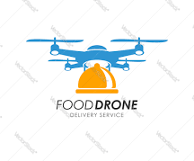
Slide 1
Taclo Drone Delivery Project Plan
Date: 26th Nov’22
Group E
Deepali Solanki
Ratnadeep Nag
Guided By
Deepak Kharol

Slide 2




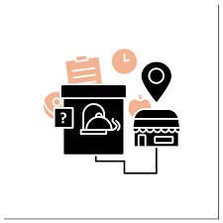


Taclo Drone Delivery : INTRODUCTION
Project Backgrounds
Taclo’s Focus
70% platform order placement during peak hours : Lunch and Dinner
Peak Hours high traffic limits restaurant serviceability to few kilometers (avg 4 kms)
Explore Drone Enabled Delivery Systems for its on-demand supply chain
Increase Presence via Creating private brands in various cuisines : Japanese, Mexican, Continental
Identified 9 Strategic Locations with high order volume
Developing Cloud Kitchen with Drone Depot in 9 strategic locations
Objective
Developing Hub around high concentration of restaurants and servicing thru Drone
Launch “Tempo” delivery feature on Customer App interface

Slide 3
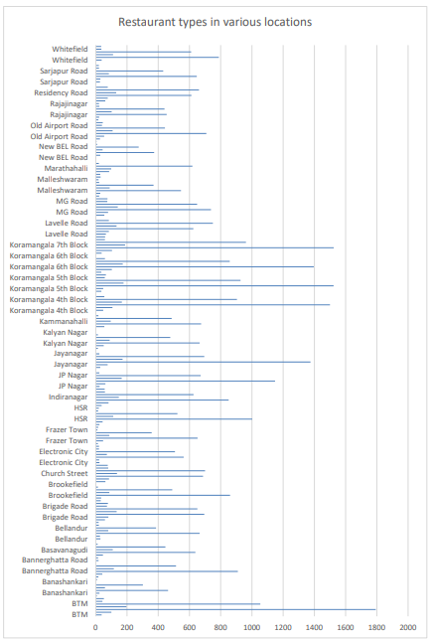
TACLO DRONE DELIVERY : STRATEGIC LOCATIONS
Introduction: The location has a significant impact on the success of the Drone delivery project. In our work, we have chosen a location as a business representative and have tried to analyze how the success of Drone delivery model can be affected by its location. To address this question, we analyzed the Zomato restaurant data-set of Bangalore - also called The Silicon Valley of India, Bangalore has a population of 10 million and is the country’s third most populated city. Cuisines from all over the world can be found here. Zomato dataset for Bangalore restaurants is collected from Kaggle.com. After the analysis of data, it is found that 50% of people prefer the food to be delivered at home whereas about 35% people prefer to dine out. According to global reports, Bengaluru has world’s worst traffic congestion with average of 4km/hr during peak hours.
Fig 1 :The number of restaurant with delivery type concentration in various locations of Bangalore City
Source : Location Based Restaurant Preferences in Bangalore by Anupam Bhatia, Sneha Sneha :: SSRN

Slide 4
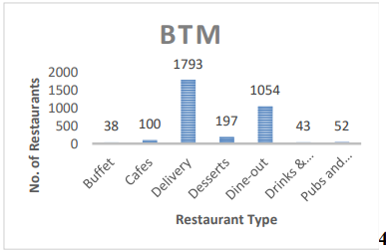
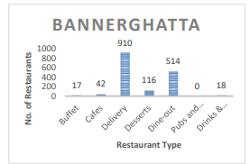
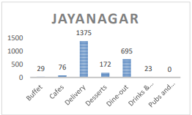
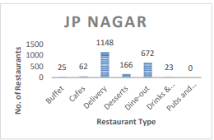
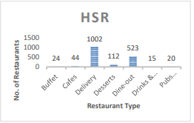
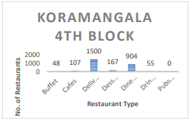
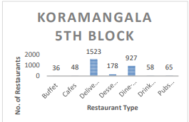
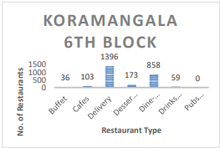
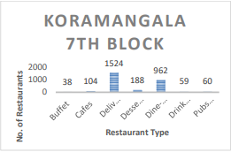
TACLO DRONE DELIVERY : STRATEGIC LOCATIONS
Identified 9 Strategic Locations with Higher concentration of Delivery type restaurants & highest traffic jams rates during peak hours
Source : Location Based Restaurant Preferences in Bangalore by Anupam Bhatia, Sneha Sneha :: SSRN

Slide 5
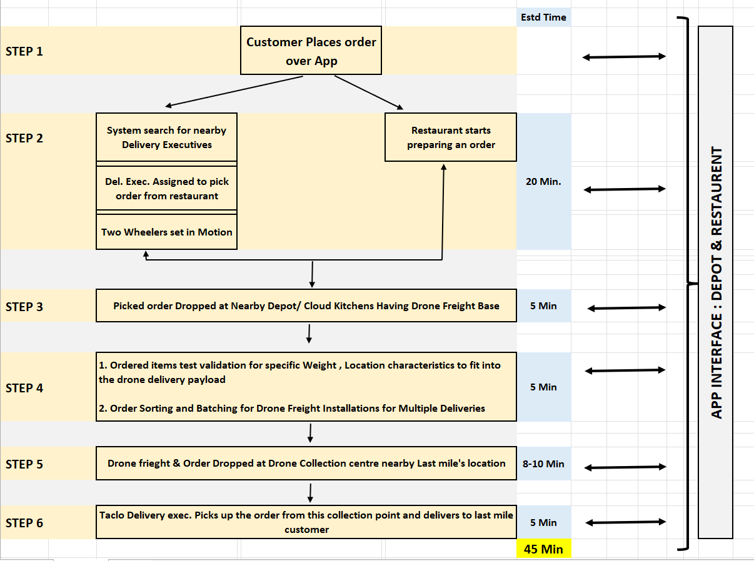
TACLO DRONE DELIVERY OPERATIONAL MODEL
Model Operational Consideration
Average Delivery Time = 30-45 minutes
50% Food Prep
50% Delivery
Key Specifications
Max. Carry Weight | 5 Kg
Radius (for Drone Freight) | Up to 4 Kms
Promising Last Mile Delivery | Within 45 Minutes
Software & Technology | AI Operational, Automated, Built In Camera, GPS

Slide 6
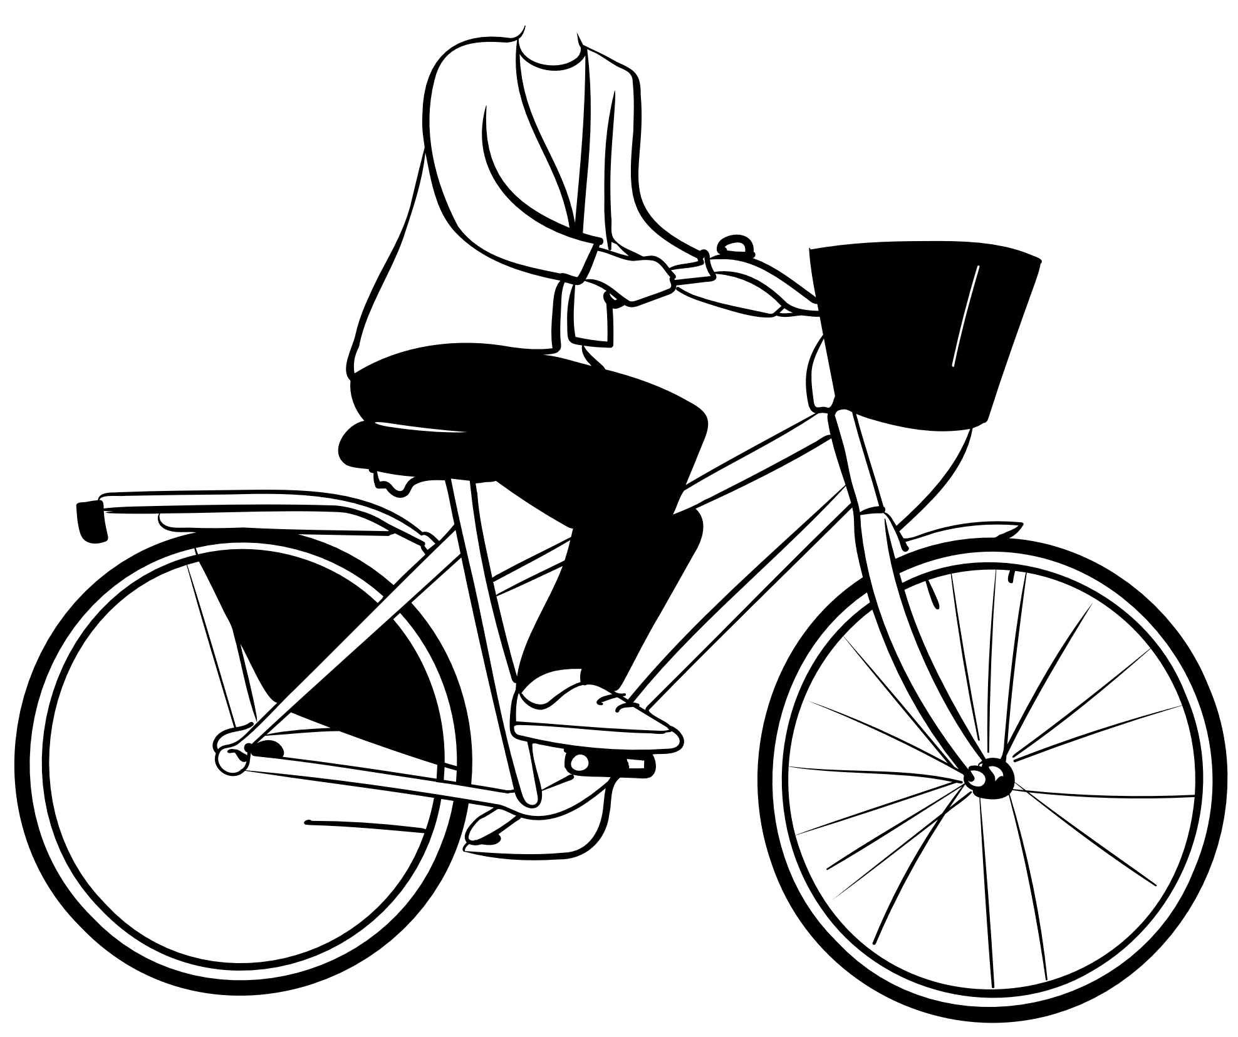
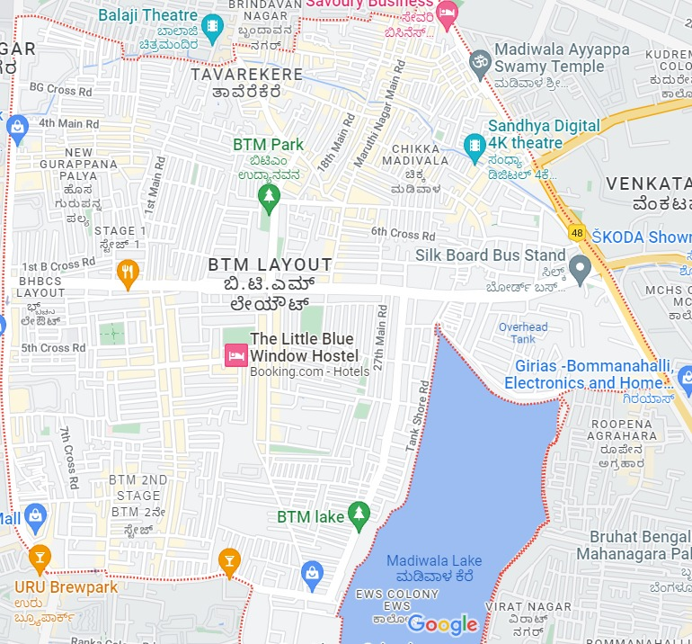
TACLO : APP DELIVERY PROCESS & CUSTOMER APP FUNNEL
C
C
Delivery Process & Stakeholders
DS
 | Customer
 | Drone Hub Station
 | Hub
 | Restaurants
 | Delivery partner
C
C
DS
DS
HUB
HUB
Operation Overview by Location Segment
C
Unit In Nos.
Location Segment | Hub/ Delivery Station | Drones | Delivery Manpower | Station Manpower
All 9 HUB’s | 27 | 25 | 65 | 72
BTM (1 HUB) | 3 | 3 | 9 | 8
DS
C
Log In
Listing
Restaurant Menu
Order Booking
Tempo
Order Confirmation
Cart
Payment
Taclo Customer App Funnel

Slide 7

Cost Benefit Calculation Overview _All Hubs
S.No. | Cost Particulars _All Hub Locations | Amount (in Cr)
1 | Developing/ Fixed Cost | 7
2 | Operating Cost | 7
 | Total Cost | 14
S.No. | Revenue Particulars _All Hub Locations | UoM | Value
A | Revenues from Order (Tempo)
i | Minimum Order Value | Nos. | 420
ii | Surge price charges | % | 10%
iii | Est Monthly orders All Hubs | Nos. | 211680
iv | Est revenue | In Cr | 10
B | Revenue From Restaurant
i | Est Revenue | In Cr. | 18
 | Total Revenue | In Cr | 28
Delivery Executive Salary Calculation
COST OF Delivery MANPOWER | Peak Hrs | Non Peak Hrs
Orders per run | 3 | 2
Orders per Hr | 9 | 2
Total orders | 54 | 6
Commission per order (Rs) | 2 | 55
Commission per day(Rs) | 648 | 330
Commission per month (Rs) | 19440 | 9,900
Fixed Salary per month (Rs) | 4,000
Total Earnings (Rs) |  | 33340
Goodness of the Model
30% reduction in fuel expenses of delivery boy resulting in Increased net income
Increased Net Income of delivery boy sufficing retention effectively
70 % Reduction in Delivery Operation Cost
Increased Order Efficiency for both Company & Restaurant during Peak Hrs.

Slide 8
Key Assumptions _CB Analysis
Table 1: Assumptions for Tempo Delivery Duration
Radius Distance (Kms) | 4
Avg Speed (Kmph) | 40
Drone Flight Time (Min) | 8
Load & Check Time (Min) | 5
Pick Up Time (Min) | 5
Drop Time (Min) | 5
Prep Time (Min) | 20
Total Duration (Min) | 43
Table 2 : Peak Hours Assumption
Period | Peak Opr Hrs | Total peak Hours | Non peak
A'noon | 12 - 3 pm | 3 | 3
Even'g | 7 - 10 Pm | 3 | 3
Total |  | 6 | 6
Table 3 : Target Order & Resource Analysis
Assumptions |  |  | 70% | 45% | 6% | 6 | 6 | 35% | 35%
Week Days | Orders |  | Peak Hour orders | Location |  | Per Hour (Peak/6 Hr.) |  | Target Orders |  | Drone Required Per Hour |  | Delivery Person Required | Delivery Person Required
Week Days | % | Nos. |  | All Strategic | BTM/ Per Loc. | All Strategic | BTM/ Per Loc. | All Strategic | BTM/ Per Loc. | All Strategic | BTM/ Per Loc. | All Strategic | BTM/ Per Loc.
Mon | 12% | 53760 | 37632 | 16934.4 | 2258 | 2822 | 376 | 988 | 132 | 14 | 2 | 37 | 5
Tue | 12% | 53760 | 37632 | 16934.4 | 2258 | 2822 | 376 | 988 | 132 | 14 | 2 | 37 | 5
Wed | 13% | 58240 | 40768 | 18345.6 | 2446 | 3058 | 408 | 1070 | 143 | 15 | 2 | 40 | 5
Thurs | 13% | 58240 | 40768 | 18345.6 | 2446 | 3058 | 408 | 1070 | 143 | 15 | 2 | 40 | 5
Fri | 14% | 62720 | 43904 | 19756.8 | 2634 | 3293 | 439 | 1152 | 154 | 16 | 2 | 43 | 6
Sat | 17% | 76160 | 53312 | 23990.4 | 3199 | 3998 | 533 | 1399 | 187 | 19 | 3 | 52 | 7
Sun | 19% | 85120 | 59584 | 26812.8 | 3575 | 4469 | 596 | 1564 | 209 | 22 | 3 | 58 | 8
Total | 100% | 448000 | 313600 | 141120 | 18816 | 3360 | 448 | 8232 | 1098 | 22 | 3 | 58 | 8
 |  |  |  |  |  |  |  | Reserve |  | 25 | 3 | 65 | 9
 | Table 4: Estimated Sales
S.No | Particulars | Value
1 | Minimum Order Value | 420
2 | Surge price charges | 10%
3 | Est deliveries per run | 3
4 | Est time for load, run & battery swap (Min) | 15
5 | Est hourly deliveries | 12
6 | Est Daily deliveries | 72
7 | Est Annual orders All Hubs | 211680
8 | Est Annual orders BTM Hub | 28224
9 | Est revenue All Hub (in Cr) | 17

Slide 9
Key Assumptions _CB Analysis
Main Assumptions for CB Analysis | Main Assumptions for CB Analysis
S.No. | Particulars | Value
1 | Target Order Conversion | 35%
2 | YoY Growth Rate | 25%
3 | Avg Order Value | 420
4 | AOV Growth Rate | 5%
5 | Earning From Customer | 20%
6 | Earning From Restaurant per order | 70/-
7 | Premium Packaging Cost per order | 5/-
8 | Tax | 28%
9 | Station Manpower Salary Growth YoY | 5%
10 | Delivery Manpower Salary Growth YoY | 5%
11 | Project Team Salary Growth YoY | 8%
12 | Drone Life (Yrs) | 3
13 | Electrical & Civil & Solar Infra Life (Yrs) | 20
14 | E Bike Subscription Growth | 5%
15 | Interest | 10%
16 | EV Van Life (Yrs) | 10
17 | IT Set Up (Yrs) | 5
18 | Office IT set UP Yrs | 3
19 | Office Furniture Yrs | 5
20 | Operations Maintenance Cost | 5%
21 | Manpower Growth YoY | 25%
Table 1 : COST OF DRONE OPERATION
Particulars | Values
Drone cost (Rs) | 130000
Avg Drone life(m) | 36
Monthly purchase Drone cost | 3611
Battery life (m) | 3
Batteries reqd in lifetime | 12
Battery cost (Rs) | 13000
Monthly battery cost | 4333
Monthly Drone Maintenance(Rs) | 6500
UIN Licence (5 yrs) (Rs) | 1000
Monthly License Cost(Rs) | 28
Initial per Drone Cost | 150500
Table 2 : SETUP COST OF STATION INFRASTRUCTURE
Particulars | Values
Solar setup (5 kb) | 450000.00
Electricity works | 500000.00
Civil Works | 250000.00
No of chargers | 3
Price of chargers | 247000.00
Total price of chargers | 741000.00
Drones reqd per HUB | 3
Cost of Drone setup | 451500.00
No. of location Hubs | 9
Total setup cost BTM HUB | 2392500.00
Total setup cost For all Hubs | 21532500.00
Table 3: COST OF HUB & Station MANPOWER
Particulars | Values
HUB operations Manpower | 2
Station Manpower (3 Station) | 3
Additional manpower (leave factor) | 1
Total Operations manpower per location | 6
Salary per Operations executive | 10000
Total Operations manpower Cost | 60000
Electrical technician required | 2
Electrical technician salary | 15000
Total cost for Electrical technician | 30000
No. of location Hubs | 9
Total Cost BTM HUB | 90000
Total Cost ALL HUBS | 810000
Table 4: MONTHLY COST OF STATION INFRASTRUCTURE
Particulars | Values
EV VAN Cost | 900000
EV VAN LIFE (months) | 120
EV VANS REQD | 3
EV VAN cost in months | 22500
Power consumption Pm (KW) | 150
Price per KW | 166
Est supply from solar (Kw) | 120
Power chargable | 30
Payment for power supply | 4980
Maintenance | 10000
E-bike subscription | 80
E-bike required | 6
Total E-bike cost | 14400
Total Location Hubs | 9
Total Monthly Cost | 51880
Total Monthly Cost for All Locations | 466920

Slide 10

Financial Analysis _ Taclo Drone Delivery
Taclo Drone Delivery Cost Benefit Analysis
S.No. | STAGE 1 - Identified Cost & Benefits | STAGE 2 - Assign Values to C&B | STAGE 3 : Cash Flow Year on Year (Rs in Cr)
I | Cost & Benefit | Rs in Cr | Year 1 | Year 2 | Year 3
1 | Developing/ Fixed Cost | 7 | 7 | 3 | 3
2 | Operating Cost | 7 | 7 | 9 | 10
II | Revenues/ Benefits | 28 | 28 | 32 | 41
III | EBITDA All Hubs | 15 | 15 | 20 | 27
IV | Total Depreciation | 0.65 | 0.65 | 0.32 | 0.32
VI | EBIT | 20 | 20 | 27 | 38
VII | Interest | 0.12 | 0.12 | 0.12 | 0.12
VIII | EBT | 14 | 14 | 20 | 27
IX | Tax | 8 | 8 | 8 | 8
X | Net Profit | 6 | 6 | 12 | 20
CB ANALYSIS_TACLO DRONE DELIVERY

Slide 11
Model Comparison
Particulars | Previous Model | Drone Delivery Model
#Delivery Person Reqd. | 588 | 65
Annual Drone Cost (Rs) | - | 31,500,000.00
Avg Annual Salary per Delivery Executive (Rs) | 328500 | 400080.00
Total Avg Salary of all Delivery Executives (Rs) | 19,31,58,000 | 2,59,57,333.00
Total Delivery Ops Cost | 19,31,58,000 | 5,74,57,333.00
Cost Difference |  | 13,57,00,667.00

Slide 12
Advantages & Disadvantages of Drone Delivery Model
Advantages
Reduction in Wait Time for customers Multiple Order Delivery Compatibility Time Management Sufficing Effective resource & Order Mobilization Energy Conservation : Reducing Carbon footprint & Low Human Efforts Risk Reduction : Reduction in accidents
Disadvantages
High initial investment cost Payload & battery life of drones needs to be improved Security risks: With frequent Bomb incidents, public safety might be at risk Weather : Drone delivery is vulnerable to the adverse weather conditions Drones can cause damage to property and injury to people and not covered by insurance

Slide 13
References
https://droneanalyst.com/2014/10/02/drone-delivery-numbers
https://www.droneblog.com/drone-life-expectancy/
https://www.lendingkart.com/blog/cost-estimates-o-ev-public-charging-station/
https://auto.economictimes.indiatimes.com/news/two-wheelers/scooters-mopeds/ebikego-introduces-subscription-based-electric-bicycles-for-delivery-executives/76192796
https://www.hindustantimes.com/cities/others/power-tariff-to-go-up-in-karnataka-from-oct-1-101664045011864.html
https://homescape.solar/blog/5kw-solar-system-price-in-india-with-subsidy/
https://trucks.tractorjunction.com/en/mahindra-truck/e-supro-cargo-van
https://geoiq.io/places/BTM-Layout/VvjIk4T9fZ

Slide 14

Slide 10
THANK YOU

